Slide 1
Projet IA
Adversarial Training

Slide 2
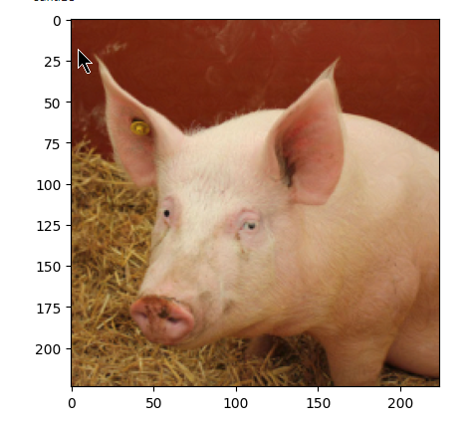
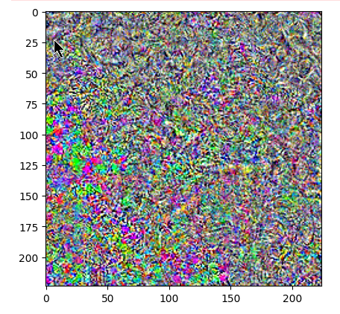
Introduction to Adversarial Training Improving Model Robustness with Adversarial Training
Background:
Adversarial attacks exploit model vulnerabilities to misclassify inputs by introducing small perturbations.
Common attacks used: FGSM, PGD (L2, L∞).
Objective:
Compare baseline model accuracy against adversarial trained models.
Evaluate robustness vs. accuracy tradeoff.
Methodology:
Implemented adversarial training using FGSM and PGD with different norms.
Fine-tuned baseline model with adversarial examples.

Slide 3
Model Performance Analysis Impact of Adversarial Training on Accuracy
Baseline Model Results:
High accuracy on clean images (96%).
Significant drop under attacks:
FGSM: 0.4, PGD: 0.3, PGD-L2: 0.
Adversarial Trained Models:
model_withattackFGSM: Improved FGSM robustness (76%) but limited performance on stronger attacks.
model_withattackPGD: Best robustness across attacks, e.g., PGD: 96%.
model_withattackPGDL2 & PGDLinf: Balanced performance; strong against PGD-L2/L∞.
Attack | None | FGSM | PGD L0 | PGD L2
Model
model_noattack | 0.96 | 0.03 | 0.00 | 0.03
model_withattackFGSM | 0.49 | 0.76 | 0.72 | 0.55
model_withattackPGD | 0.59 | 0.96 | 0.98 | 0.69
model_withattackPGDL2 | 0.96 | 0.74 | 0.73 | 0.95
Clean accuracy
Robust accuracy

Slide 4
Fine-Tuning Results and Key Takeaways Fine-Tuning Baseline for Robustness
Fine-Tuned Model Performance:
Significant improvements across all attacks:
PGD: 96%, PGD-L2: 97%.
Demonstrates adaptability of adversarial training for baseline models.
Mix Trained Model Performance:
Less Robust
Key Takeaways:
Adversarial training strengthens model robustness but may trade-off clean accuracy.
PGD is more effective for training robust models compared to FGSM.
Fine-tuning provides an efficient alternative to re-training from scratch.
Can be adaptive solution when encountering new attacks
Model | Attack | Accuracy
model_finetuned | None | 0.97
model_finetuned | FGSM | 0.96
model_finetuned | PGD | 0.97
model_finetuned | PGD L2 | 0.97
Model | Attack | Accuracy
model_mix | None | 0.98
model_mix | FGSM | 0.54
model_mix | PGD | 0.51
model_mix | PGD L2 | 0.95

